Slide 1
SPATIAL THINKING
Spatial thinking is thinking that finds meaning in the shape, size, orientation, location, direction or trajectory, of objects, processes or phenomena, or the relative positions in space of multiple objects, processes or phenomena. Spatial thinking uses the properties of space as a vehicle for structuring problems, for finding answers, and for expressing solutions.
National Research Council, 2006

Slide 2
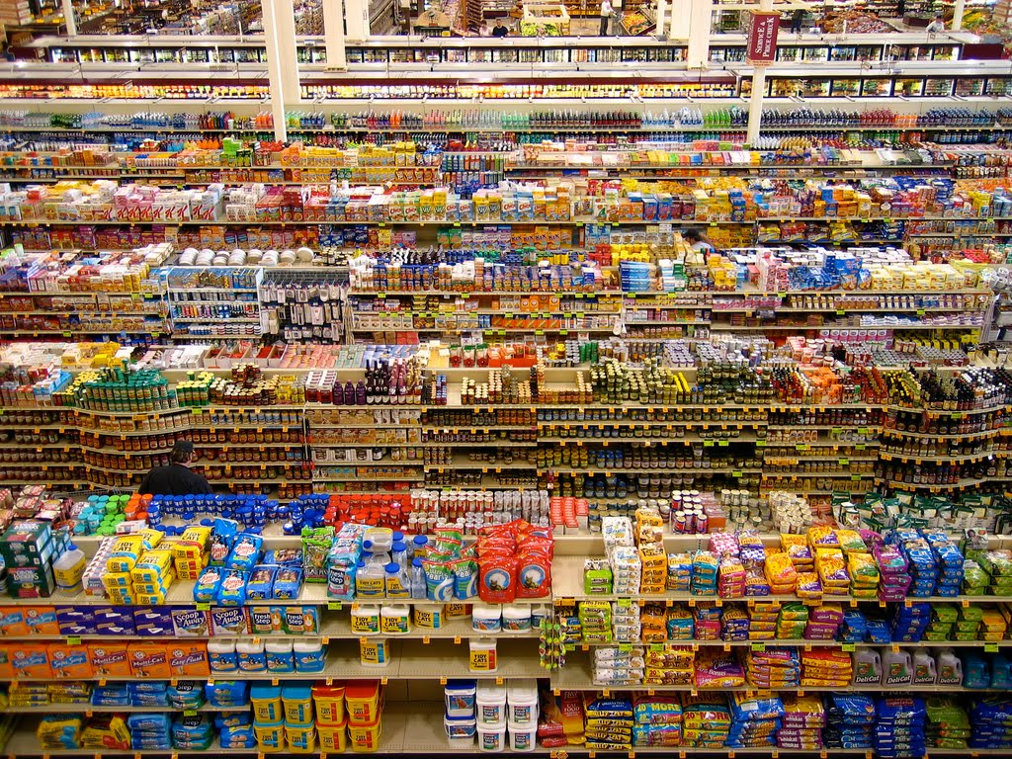
THE
SPATIAL SUPERMARKET

Slide 3
SUPERMARKET SPATIALITY
In what ways is location important in a grocery store?
Are there regions in a grocery store?
What things are dispersed? Clustered?

Slide 4
SUPERMARKET SPATIALITY
location (where, specific location)
region (clustering, contiguousness)
distribution (dispersion, relative location)
distance (proximity, accessibility)
movement (flows, pathways)
landscape (aesthetic, cultural views)

Slide 5
SUPERMARKET SPATIALITY
ADDITIONAL SPATIAL CONSIDERATIONS
patterns (or lack of…)
associations
interconnections
movement
scale

Slide 6
