Slide 1
Drokpa: The Nomadic Mountain People of Tibet
Photo Essay
Diane Barker

Slide 2
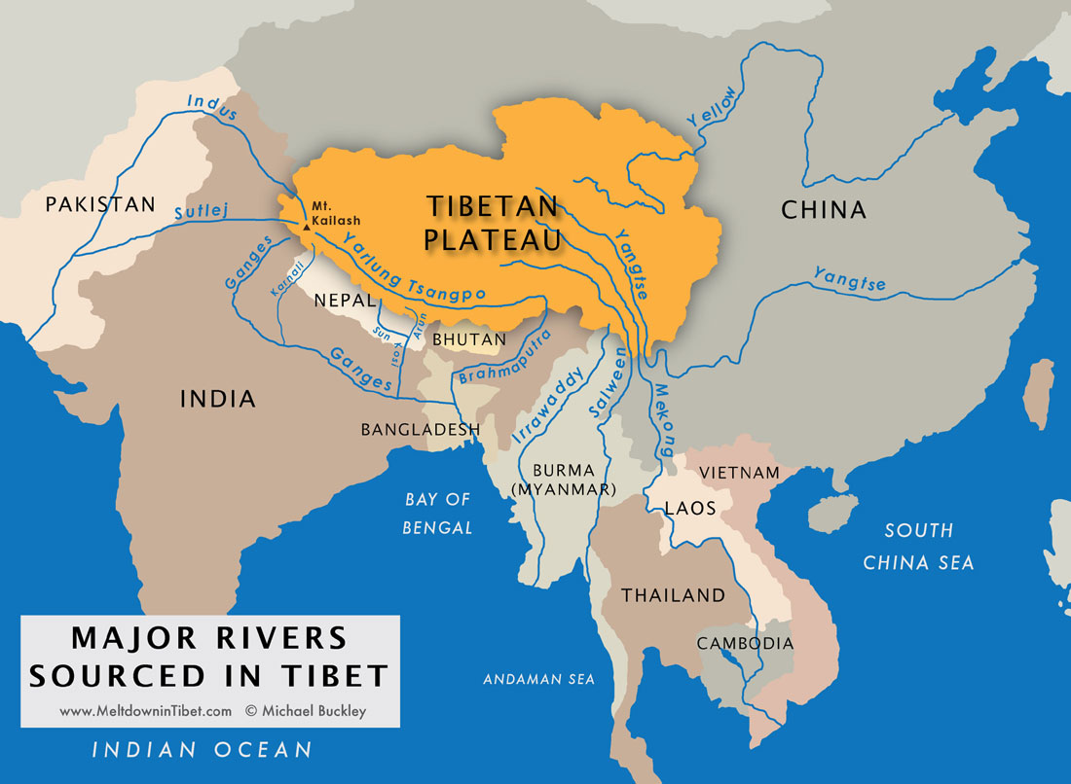
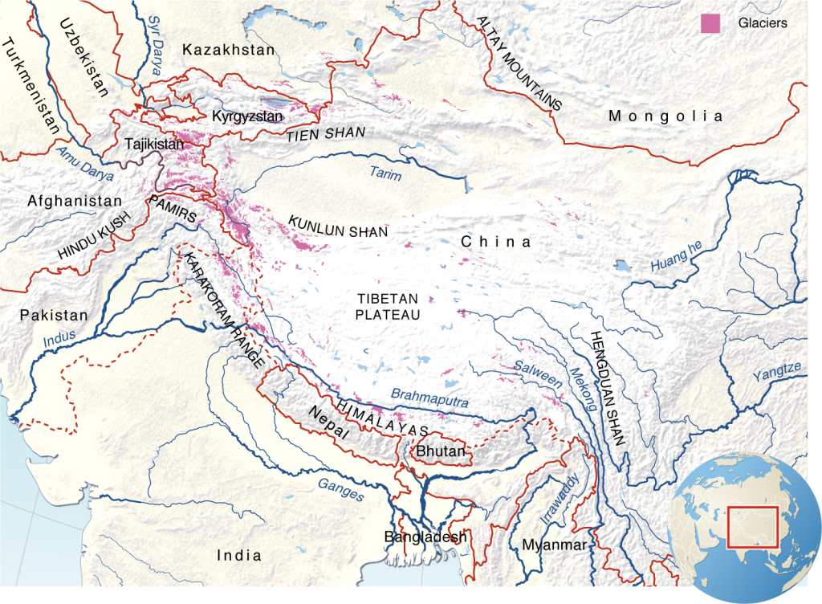
Tibetan Plateau

Slide 3
Background
Tibet is known as the “land of the snows,” because the average altitude of this area is almost 15,000 feet.
What do you know about Tibet or of the Dalai Lama, the spiritual leader of the Tibetan people?
The Dalai Lama is a Buddhist monk, who fled Tibet when the Chinese invaded that country in 1950.
He was forced to flee and in 1959, he began a permanent exile in India.
The Dalai Lama won the Nobel Peace Prize in 1989, which recognized his nonviolent campaign to cease the Chinese domination of Tibet.

Slide 4
Background
Today, nomadic peoples who have lived close to the land for thousands of years are being pressured to leave their homes in the grasslands of Tibet and resettle into modern Chinese villages.
Even the nomadic peoples who are retaining their traditions are propelling towards modernization with the increased exposure to technology such as cell phones, television, motorbikes, and energy improvements.

Slide 5
Discussion
What would your own lives possibly be like if you gave up cell phones, computers, and television. What would be lost if you resisted these forces of modernity? What might be gained?

Slide 6
Photo Essay Instructions
You will be viewing photographs taken by British photographer Diane Barker.
The photos document the lives of nomads, or Drokpa, who live in the high altitude grasslands of the Tibetan Plateau.
The Drokpa way of life is threatened due to Chinese policies that restrict the use of pastoral land and force the relocation of nomads into villages and towns.

Slide 7
Photo Essay Instructions
Read the photographer’s statement. In pairs or small groups, take note of the main activities of the Drokpa people.
Take note of the differences of photographs 1-18, which were taken in 2000 and 2001, to photographs 19-30, which were taken in recent years.
What changes have impacted the nomads and their environment between these two time periods?

Slide 8
Discussion
What factors, depicted in the photo essay, are threatening a traditional Tibetan nomadic lifestyle?

Slide 9
Discussion
Summarize the changes between the two time periods—the first part of the photo essay and the second part of the photo essay. What has been introduced into the lives of the nomads? What do you notice has disappeared?

Slide 10
Discussion
One relocated Tibetan nomad interviewed for the Pulitzer Center, explains his new life. He said, “Life is more convenient now, but I worry that Tibetan culture is disappearing.” Which photographs reflect this trend of increased convenience and “disappearing” culture? What is disappearing?

Slide 11
Discussion
Photographer Diane Barker asked a Drokpa woman how she feels about relocation and the woman replied, “Nomad life is the best because we have yogurt, milk, cheese, and yak meat that we can produce by ourselves. We don’t want to buy these kinds of products from another place.” What might be the value for the nomads of producing these foods?

Slide 12
Discussion
Author Helena Norberg-Hodge writes about the people of Ladakh, another Himalayan region that is home to the Drokpa, “Can the Ladakhis’ natural ebullience and joie de vivre survive the pressures of modernization?” (Joie de vivre is a French phrase that translates as “exuberant enjoyment of life.”) What do you think the photographer’s response would be to this question? What is your own response?

Slide 13
Assignment
The first 18 photographs from the photo essay document nomadic life approximately 15 years ago, while the second 12 represent nomadic life in recent years.
One influence depicted in the later series of photographs is the presence of technology in the form of cell phones and television.

Slide 14
Assignment
Write a paragraph explaining the positive and negative effects of technology based on your own experiences. How does technology affect your life?
Using the photos as evidence, include in your paragraph what you have noticed by comparing the older photographs from the first part of the photo essay to the more recent photographs in the second part of the photo essay.
What are your observations as phones and televisions entered the nomads’ lives? Do you notice similarities to your own life? If so, what?

